Slide 1
Chapter -13
Sinusoidal Alternating Waveforms

Slide 2
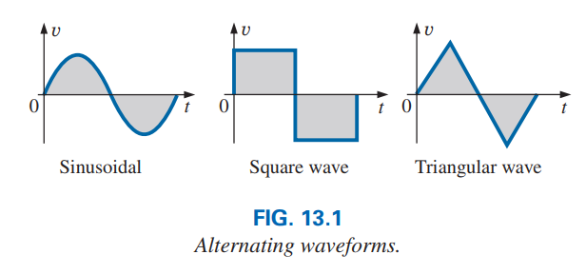
Sinusoidal Alternating Waveforms
Alternating current(ac) voltage is the time-varying voltage.
Each waveform in Fig. 13.1 is an alternating waveform sinusoidal, square-wave, or triangular.

Slide 3
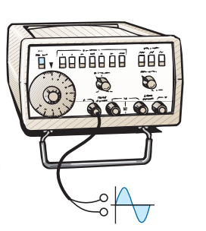
13.2 Generation
Function generators are used to control the various characteristics of the Sinusoidal ac such as the one in Fig.13.2(e).
By setting the various switches and controlling the position of the knobs on the instrument, you can make available sinusoidal voltages of different peak values and different repetition rates.
The function generator plays an integral role in the investigation of the variety of theorems, methods of analysis, and topics.

Slide 4
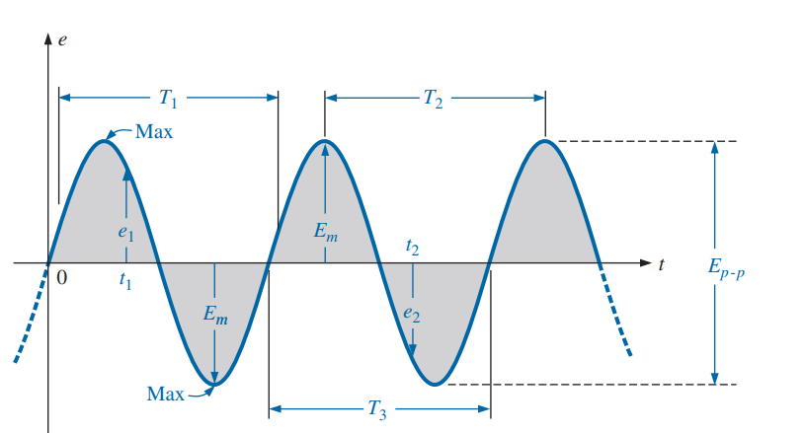
Definitions
In the sinusoidal waveform in Fig. 13.3, the vertical scaling is in voltage(volts) or current(amperes) and the horizontal scaling is in units of time.
For any quantity(voltage or current) that change with particular instant of time, a lowercase letter such as e or i is used.

Slide 5
Definitions
Waveform: The path traced by a quantity, such as the voltage in Fig. 13.3, plotted as a function of some variable such as time is called a waveform.
Instantaneous value: The magnitude of a waveform at any instant of time; denoted by lowercase letters (e1, e2 in Fig. 13.3).

Slide 6
Peak amplitude: The maximum value of a waveform as is called peak amplitude, denoted by uppercase letters.
Peak value: The maximum instantaneous value of a function as measured from the zero volt level. For the waveform in Fig. 13.3, the peak amplitude and peak value are the same.
Peak-to-peak value: The full voltage between positive and negative peaks of the waveform, that is, the sum of the magnitude of the positive and negative peaks.

Slide 7
Periodic waveform: A waveform that continuously repeats itself after the same time interval. The waveform in Fig. 13.3 is a periodic waveform.
Period (T): The time of a periodic waveform. T1 is the example period in the waveform.
Cycle: The portion of a waveform contained in one period of time is called a cycle. The cycles within T1, T2, and T3 in Fig. 13.3 are all bounded by one period of time.

Slide 8

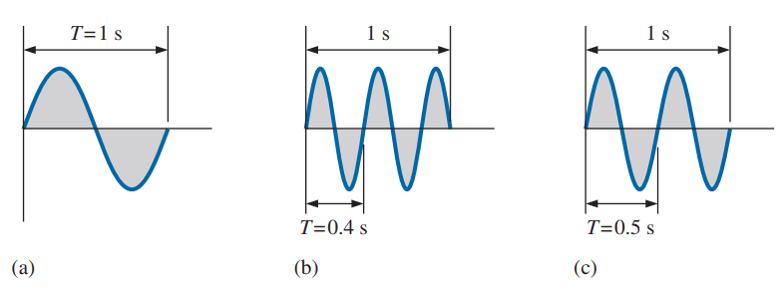
Frequency (f): The number of cycles that occur in 1s. The frequency of the waveform in Fig. 13.5(a) is 1 cycle per second.
Fig. 13.5(b), 2 and half cycles per second.
If a waveform of similar shape had a period of 0.5 s [Fig. 13.5(c)], the frequency would be 2 cycles per second.
The unit of measure for frequency is the hertz (Hz), where

Slide 9
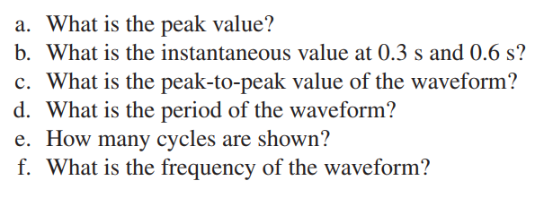
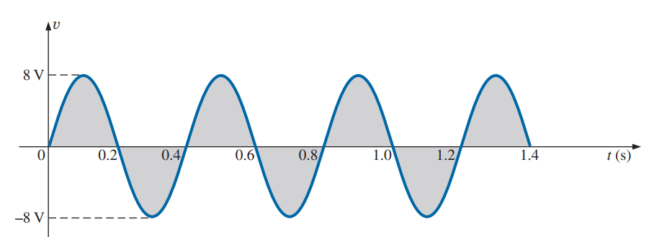
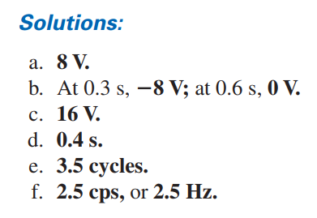

Slide 10
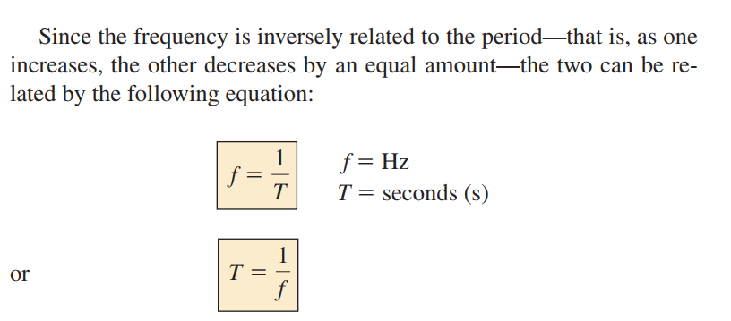
13.3 Frequency Spectrum

Slide 11
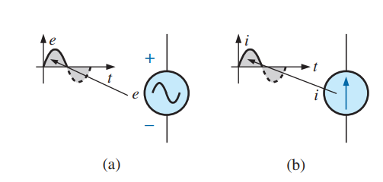
Defined Polarities and Direction
A positive sign is applied if the voltage is above the axis, as shown in Fig. 13.11(a).
For a current source, the direction in the symbol corresponds with the positive region of the waveform, as shown in Fig. 13.11(b).

Slide 12
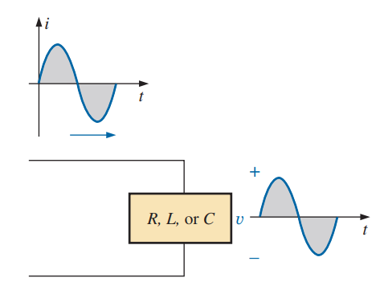
The Sinusoidal Waveform
The sinusoidal waveform is the only alternating waveform whose shape is unaffected by the response characteristics of R, L, and C elements.
In other words, if the voltage across (or current through) a resistor, inductor, or capacitor is sinusoidal in nature, the resulting current (or voltage, respectively) for each will also have sinusoidal characteristics, as shown in Fig. 13.12.

Slide 13
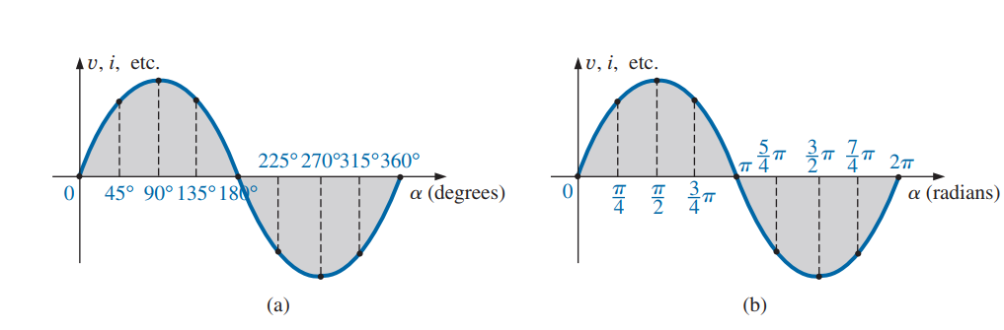
Plotting a sine wave versus (a) degrees and (b) radians.

Slide 14
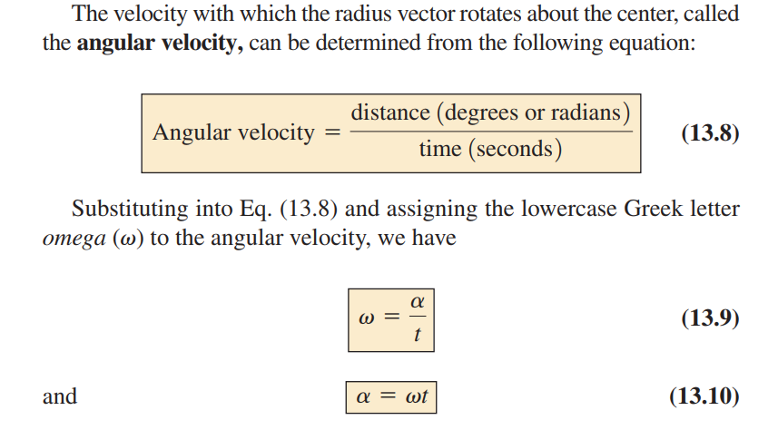

Slide 15
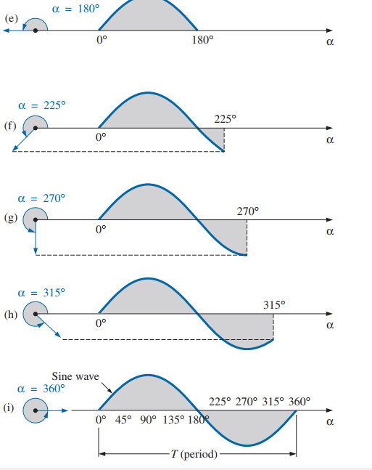
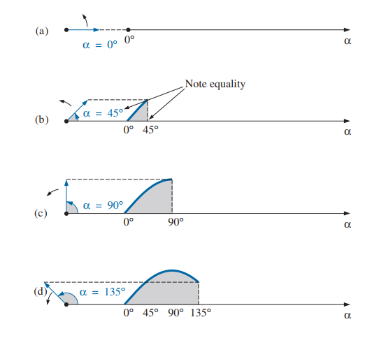

Slide 16
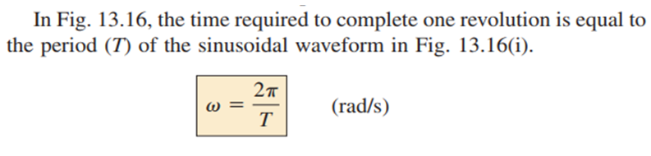
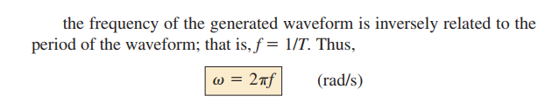
The Sinusoidal Waveform
Example: 13.4,13.5,13.6,13.7

Slide 17
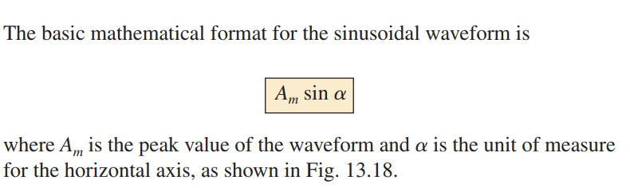
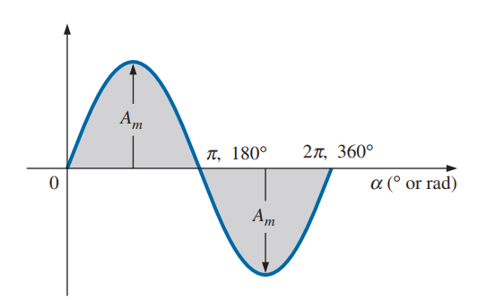
General Format for the Sinusoidal Voltage or Current

Slide 18
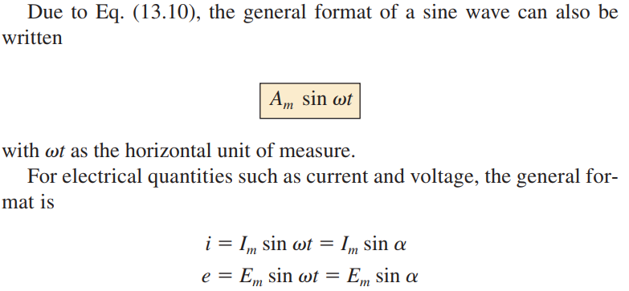
General Format for the Sinusoidal Voltage or Current

Slide 19
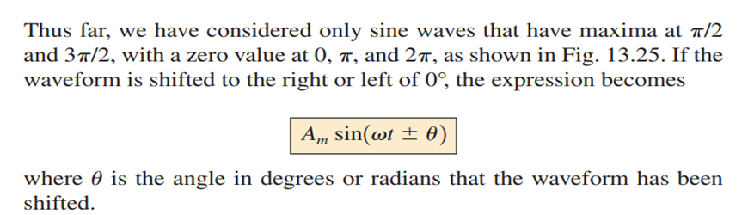
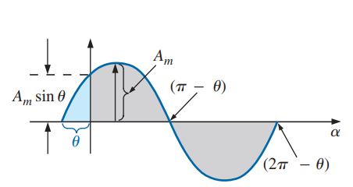
13.6 Phase Relations

Slide 20
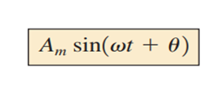
13.6 Phase Relations
If the waveform passes through the horizontal axis before 0° with a phase shift of θ , as shown in Fig. 13.27, the expression is:

Slide 21

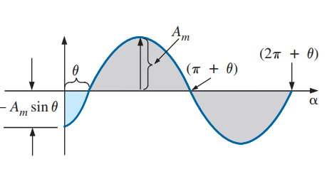
13.6 Phase Relations
If the waveform passes through the horizontal axis after 0°, as shown in Fig. 13.28, the expression is

Slide 22
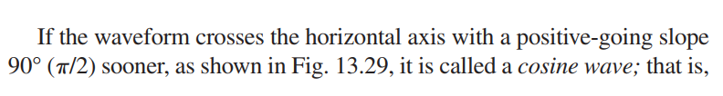
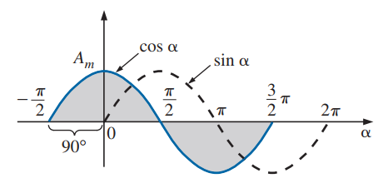
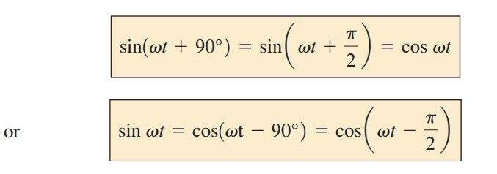

Slide 23

Phase Relations
The terms leading and lagging are used to indicate the relationship between two sinusoidal waveforms of the same frequency plotted on the same set of axes.
In Fig. 13.29, the cosine curve is said to lead the sine curve by 90°, and the sine curve is said to lag the cosine curve by 90°.
The 90° is referred to as the phase angle between the two waveforms (the waveforms are out of phase by 90°).

Slide 24
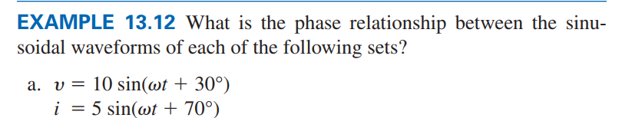
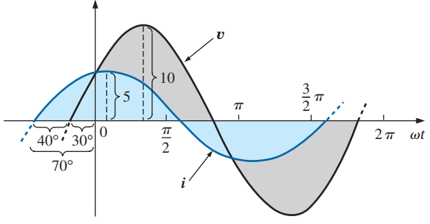


Slide 25

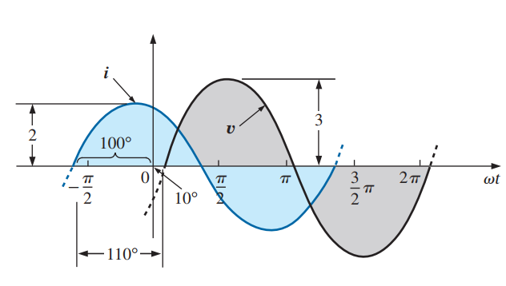


Slide 26
Thank You

